Slide 1

E-commerce order management system
Y. Satya sree : 25B11CSA51
K.Sindhu : 25B11CS408
K.Sanjana : 25B11CSA79
K.Lavanya : 25B11CS438

Slide 2

Introduction
An E-Commerce Order Management System is a software system used to manage online customer orders.
It helps customers browse products, place orders, and make payments.
The system manages the complete order process from order placement to delivery.
It stores important information such as customer details, product details, orders, and payments.
It helps sellers track, update, and manage orders efficiently.
The system reduces manual work and errors in order processing.
It provides better customer service and faster order management.
It can also manage order status, inventory, cancellations, and returns.

Slide 3
Problem statement
Managing customer orders manually is time-consuming and difficult.
It is challenging to track orders, payments, and delivery status accurately.
Manual order processing can lead to errors and duplicate orders.
Customers may not get real-time updates about their orders.
Managing large numbers of orders becomes difficult as the business grows.
There is a need to maintain customer, product, and order details in an organized way.
The system should provide easy order placement, tracking, updating, and cancellation.
The main aim is to develop a system that makes order management faster, accurate, and efficient.

Slide 4
Objectives
To manage customer orders efficiently.
To provide easy and quick order placement.
To maintain customer and product details accurately.
To track order status and delivery details.
To reduce manual work and human errors.
To manage payments and order records effectively.
To provide customers with order updates.
To support order cancellation and modification.

Slide 5
Functional Requirements
User Registration and Login – Users can create accounts and securely log in.
Product Management – Admin can add, update, delete, and view products.
Product Search – Users can search and view available products.
Shopping Cart – Users can add, remove, and update products in the cart.
Order Placement – Users can place orders by providing required details.
Payment Management – The system should process and record payments.
Order Tracking – Users can check the current status of their orders.
Order Cancellation – Users can cancel orders according to the system rules.
Order History – Users can view their previous orders.
Delivery Management – Admin can update delivery and shipping status.

Slide 6
Non-Functional Requirements
Performance – The system should respond quickly to user requests.
Security – User and payment information should be protected.
Reliability – The system should work correctly without frequent failures.
Availability – The system should be available whenever users need it.
Scalability – The system should handle an increasing number of users and orders.
Usability – The system should be simple and easy to use.
Maintainability – The system should be easy to update and maintain.
Accuracy – Order, payment, and customer information should be processed accurately.
Data Backup – Important data should be backed up to prevent data loss.
Compatibility – The system should work properly on different devices and browsers.

Slide 7
Attributes and Entities
Customer Customer ID Name Email Phone
Product Product_ID Product Name Price Quantity
Order Order ID Customer ID Order Date Status
Payment Payment ID Order ID Amount Payment Status
Delivery Delivery_ID Order ID DeliveryDate Status

Slide 8
End Users of the System
Customers – Browse products, place orders, make payments, and track deliveries.
Admin – Manages products, customers, orders, payments, and system activities.
Warehouse Staff – Manages product stock, packing, and order preparation.
Delivery Staff – Handles order delivery and updates delivery status.
Customer Support Staff – Handles customer queries, complaints, returns, and cancellations.
Store Manager – Monitors sales, inventory, and overall order management.

Slide 9
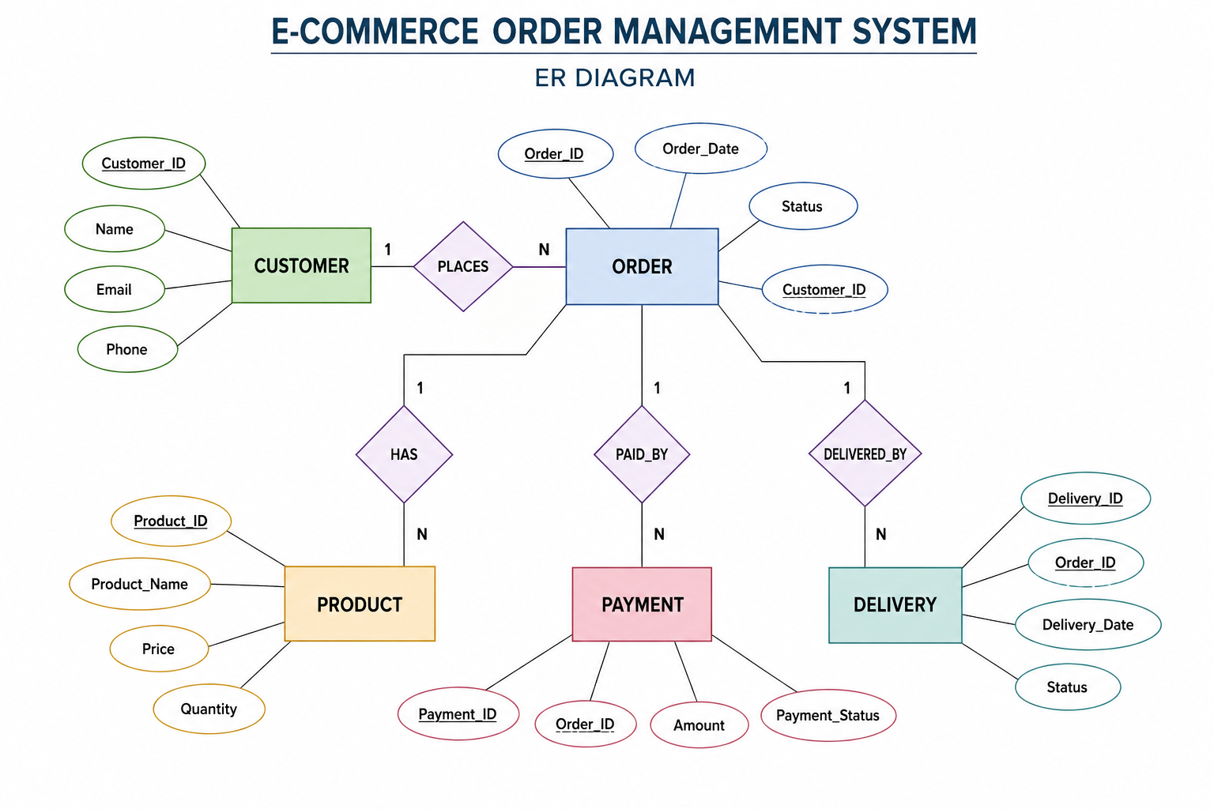
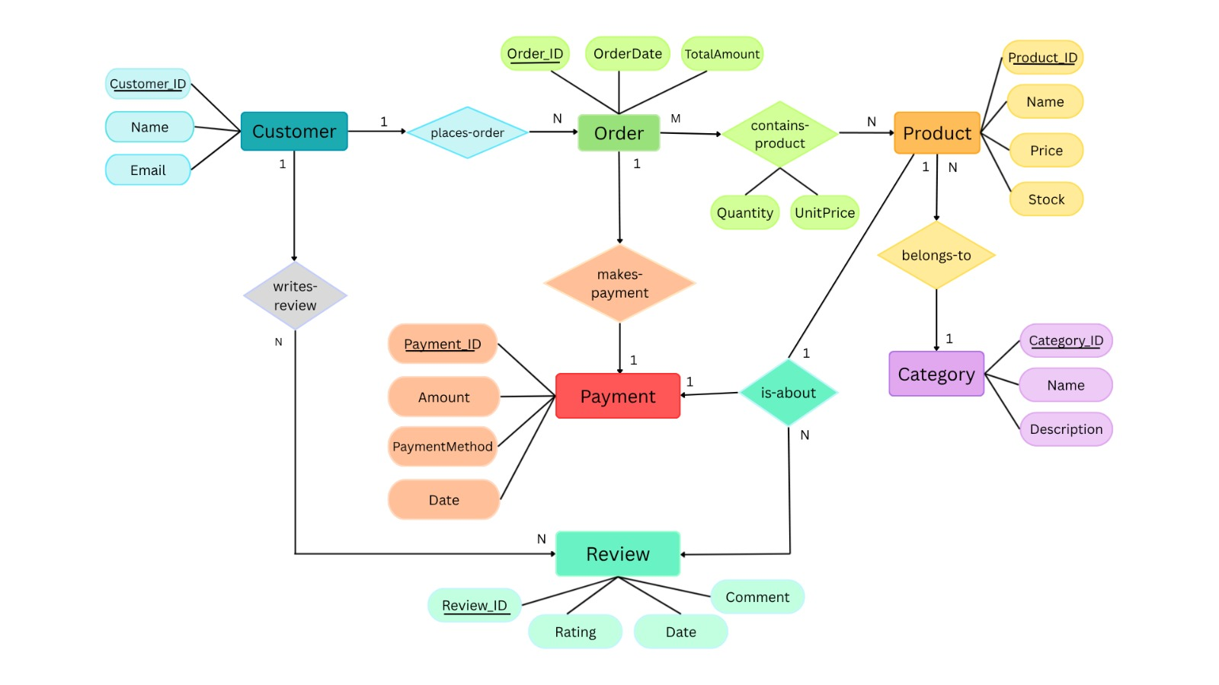

Slide 10
2. SQL tables and attributesTable
Table | Attributes
CUSTOMER | Customer_ID (PK), Name, Email, Phone, Address
CATEGORY | Category_ID (PK), Name, Description
PRODUCT | Product_ID (PK), Name, Price, Stock, Category_ID (FK)
ORDERS | Order_ID (PK), Customer_ID (FK), OrderDate, TotalAmount
ORDER_DETAILS | Order_Detail_ID (PK), Order_ID (FK), Product_ID (FK), Quantity, UnitPrice
PAYMENT | Payment_ID (PK), Order_ID (FK), Amount, PaymentMethod, PaymentDate, PaymentStatus
REVIEW | Review_ID (PK), Customer_ID (FK), Product_ID (FK), Rating, CommentText, ReviewDate

Slide 11
Create tables in Oracle:
1.customer
CREATE TABLE Customer (
Customer_ID NUMBER(5) PRIMARY KEY,
Name VARCHAR2(50) NOT NULL,
Email VARCHAR2(100) UNIQUE NOT NULL,
Phone VARCHAR2(15),
Address VARCHAR2(100)
);
2.Category
CREATE TABLE Category (
Category_ID NUMBER(5) PRIMARY KEY,
Name VARCHAR2(50) NOT NULL,
Description VARCHAR2(100)
);

Slide 12
3.Product
4.orders
CREATE TABLE Product (
Product_ID NUMBER(5) PRIMARY KEY,
Name VARCHAR2(50) NOT NULL,
Price NUMBER(10,2) CHECK (Price > 0),
Stock NUMBER(5) CHECK (Stock >= 0),
Category_ID NUMBER(5),
CONSTRAINT fk_product_category
FOREIGN KEY (Category_ID)
REFERENCES Category(Category_ID)
);
CREATE TABLE Orders (
Order_ID NUMBER(5) PRIMARY KEY,
Customer_ID NUMBER(5),
OrderDate DATE NOT NULL,
TotalAmount NUMBER(10,2) CHECK (TotalAmount >= 0),
CONSTRAINT fk_order_customer
FOREIGN KEY (Customer_ID)
REFERENCES Customer(Customer_ID)
);

Slide 13
5.Order Details
6.Payment
CREATE TABLE Order_Details (
Order_Detail_ID NUMBER(5) PRIMARY KEY,
Order_ID NUMBER(5),
Product_ID NUMBER(5),
Quantity NUMBER(5) CHECK (Quantity > 0),
UnitPrice NUMBER(10,2) CHECK (UnitPrice > 0),
CONSTRAINT fk_details_order
FOREIGN KEY (Order_ID)
REFERENCES Orders(Order_ID),
CONSTRAINT fk_details_product
FOREIGN KEY (Product_ID)
REFERENCES Product(Product_ID)
);
CREATE TABLE Payment (
Payment_ID NUMBER(5) PRIMARY KEY,
Order_ID NUMBER(5),
Amount NUMBER(10,2) CHECK (Amount > 0),
PaymentMethod VARCHAR2(30),
PaymentDate DATE,
PaymentStatus VARCHAR2(20),
CONSTRAINT fk_payment_order
FOREIGN KEY (Order_ID)
REFERENCES Orders(Order_ID)
);

Slide 14
7.Review
CREATE TABLE Review (
Review_ID NUMBER(5) PRIMARY KEY,
Customer_ID NUMBER(5),
Product_ID NUMBER(5),
Rating NUMBER(1) CHECK (Rating BETWEEN 1 AND 5),
CommentText VARCHAR2(200),
ReviewDate DATE,
CONSTRAINT fk_review_customer
FOREIGN KEY (Customer_ID)
REFERENCES Customer(Customer_ID),
CONSTRAINT fk_review_product
FOREIGN KEY (Product_ID)
REFERENCES Product(Product_ID)
);

Slide 15
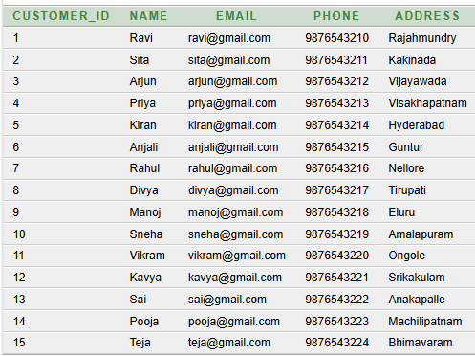
Inserting 15 Records into Each Table
Inserting values into customer tables
SQL>select * from customer;

Slide 16
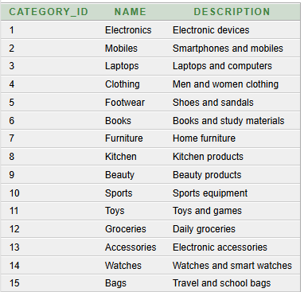
Inserting values into Category table:
SQL>select * from Category;

Slide 17
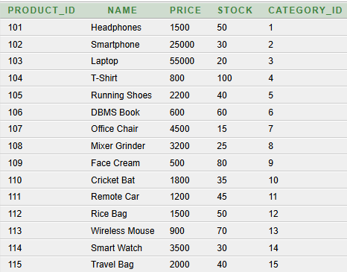
Inserting values into product table
SQL>select * from product;

Slide 18
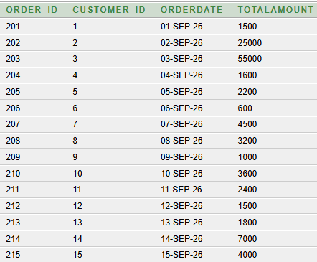
Inserting values into orders table
SQL>select * from Order;

Slide 19
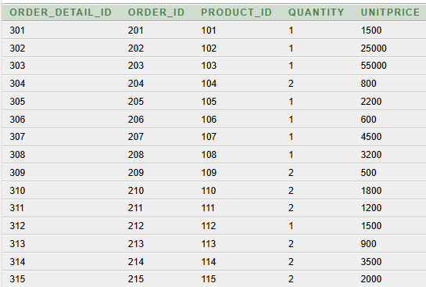
Inserting values into order_Details table
SQL>select * from Order_Details;

Slide 20
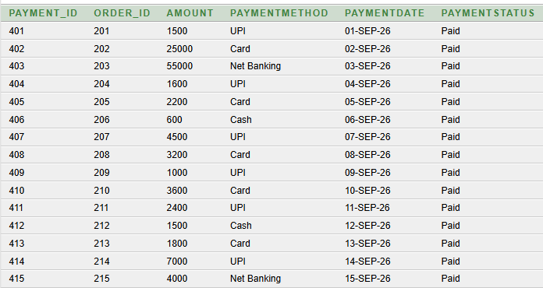
Inserting values into payment table
SQL>select * from Payment;

Slide 21
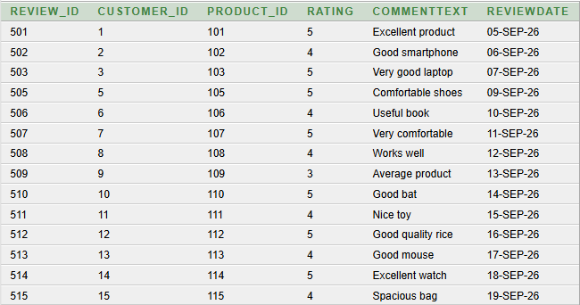
Inserting values into Review table
SQL>select * from Review

Slide 22
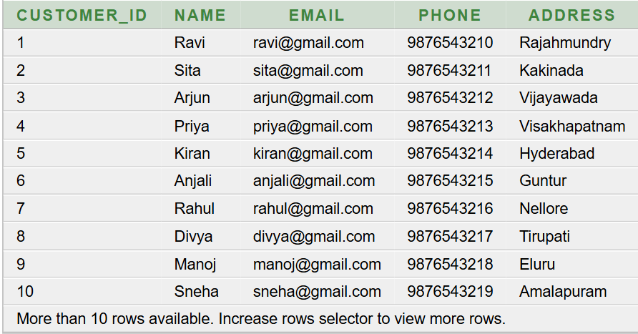
Basic SQL Queries & Outputs
Query 1: Display all customers.
SELECT * FROM Customer;
Output:

Slide 23
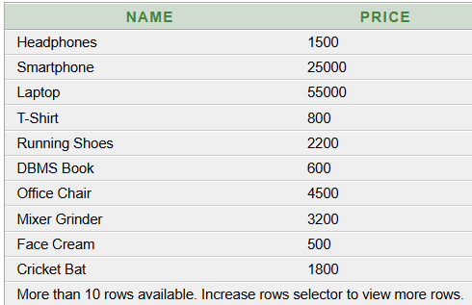
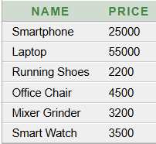
Query 2: Display product names and prices.
SELECT Name, Price
FROM Product;
Output:
Query 3: Display products whose price is greater than 2000.
SELECT Name, Price
FROM Product
WHERE Price > 2000;
Output:

Slide 24
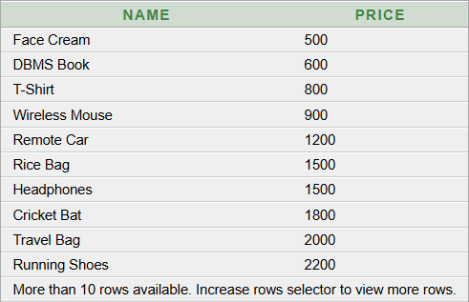
Query 4: Display customers from Rajahmundry.
SELECT *
FROM Customer
WHERE Address = 'Rajahmundry’;
Output:
Output:
Query 5: Display products in ascending order of price.
SELECT Name, Price
FROM Product
ORDER BY Price ASC;

Slide 25

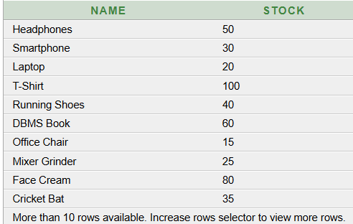

Query 6: Find the maximum product price.
SELECT MAX(Price) AS Maximum_Price
FROM Product;
Output:
Query 8 – Display products with their stock
SELECT Name, Stock
FROM Product;
Output:
Query 7: Find the average product price.
SELECT AVG(Price) AS Average_Price
FROM Product;
Output:

Slide 26
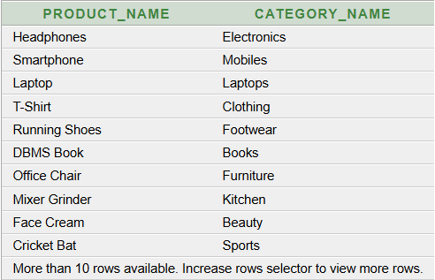

Advanced Queries & outputs
Query 1: Find products whose price is greater than the average product price.
SELECT Name, Price
FROM Product
WHERE Price > (SELECT AVG(Price) FROM Product);
Output:
Output:
Query 2: Display product names with their category names.
SELECT p.Name AS Product_Name,
c.Name AS Category_Name
FROM Product p
JOIN Category c
ON p.Category_ID = c.Category_ID;

Slide 27

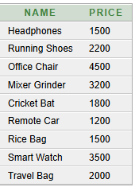
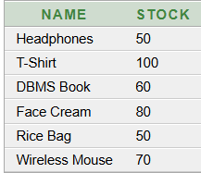
Query 4: Find the most expensive product
SELECT Name, Price
FROM Product
WHERE Price = (SELECT MAX(Price) FROM Product);
Output:
Advanced Query – Find products within a price range
SELECT Name, Price
FROM Product
WHERE Price BETWEEN 1000 AND 5000;
Output:
Query 5: Find products with stock greater than the average stock.
SELECT Name, Stock
FROM Product
WHERE Stock > (SELECT AVG(Stock) FROM Product);
Output:

Slide 28
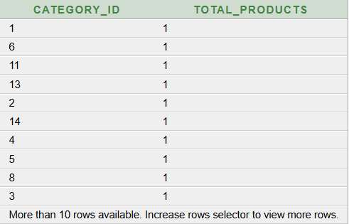
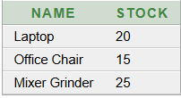
Query 6 – Find products with low stock
SELECT Name, Stock
FROM Product
WHERE Stock < 30;
Output:
Output:
Query 7– Count products in each category
SELECT Category_ID, COUNT(*) AS Total_Products
FROM Product
GROUP BY Category_ID;

Slide 29

Query 8– Find the second-highest product price
SELECT MAX(Price) AS Second_Highest_Price
FROM Product
WHERE Price < (SELECT MAX(Price) FROM Product);
Output:

Slide 30
Normalization Upto 3NF
1NF – First Normal Form
1NF means each column should contain only one value.
There should be no repeated or multiple values in a single cell.
Example: In our E-Commerce system, each order should have separate product details.
2NF – Second Normal Form
2NF means the table should be in 1NF and all data should depend on the complete primary key.
It helps to reduce unnecessary repeated data.
Example: Customer details and product details can be stored in separate tables.
3NF – Third Normal Form
3NF means the table should be in 2NF and non-key data should depend only on the primary key.
It helps to avoid unnecessary dependencies and keeps the database organized.

Slide 31
1NF – First Normal Form
ORDER_ID | CUSTOMER_ID | CUSTOMER_NAME | PRODUCT_ID | QUANTITY
O101 | C01 | Ravi | P101 | 2
O102 | C02 | Priya | P102 | 1
O103 | C03 | Anu | P103 | 3
O104 | C01 | Ravi | P104 | 1
O105 | C04 | Kiran | P101 | 2
O106 | C05 | Sita | P105 | 1
ORDER_ID → CUSTOMER_ID, CUSTOMER_NAME
PRODUCT_ID → PRODUCT_NAME, PRICE
(ORDER_ID, PRODUCT_ID) → QUANTITY
PRIMARY KEY: (ORDER_ID, PRODUCT_ID)
Redundancy :In 1NF, all values are atomic, but some customer details may be repeated when the same customer places multiple orders. This can cause data redundancy.

Slide 32
Second Normal Form (2NF)
Orders Table
Order_Details Table
ORDER_ID | CUSTOMER_ID | CUSTOMER_NAME
O101 | C01 | Ravi
O102 | C02 | Priya
O103 | C03 | Anu
O104 | C01 | Ravi
O105 | C04 | Kiran
O106 | C05 | Sita
ORDER_ID | PRODUCT_ID | QUANTITY
O101 | P101 | 2
O102 | P102 | 1
O103 | P103 | 3
O104 | P104 | 1
O105 | P101 | 2
O106 | P105 | 1
In the 1NF table, customer details and order details are stored together. Here, CUSTOMER_NAME depends only on CUSTOMER_ID, not on the complete key. This creates partial dependency and data repetition.
Redundancy:2nfpartial dependency is removed by separating customer details from order details. Therefore, repeated customer information is reduced and redundancy is minimized.

Slide 33
Second Normal Form (2NF)
In our E-Commerce Order Management System, the data is decomposed into two tables: CUSTOMER and ORDER_DETAILS. The CUSTOMER table stores customer information, while the ORDER_DETAILS table stores order and product information. In the original table, CUSTOMER_NAME depends only on CUSTOMER_ID, which causes partial dependency and data redundancy. To remove this dependency, CUSTOMER_NAME is moved to the CUSTOMER table. The ORDER_DETAILS table contains ORDER_ID, CUSTOMER_ID, PRODUCT_ID, and QUANTITY. Thus, partial dependency is removed, data redundancy is reduced, and the tables are converted into Second Normal Form (2NF).

Slide 34
Third Normal Form (3NF)
Customer Table
Orders Table
CUSTOMER_ID | CUSTOMER_NAME
C01 | Ravi
C02 | Priya
C03 | Anu
C04 | Kiran
C05 | Sita
ORDER_ID | PRODUCT_ID | QUANTITY
O101 | P101 | 2
O102 | P102 | 1
O103 | P103 | 3
O104 | P104 | 1
O105 | P101 | 2
O106 | P105 | 1
Primary Key: CUSTOMER_ID
Primary Key: (ORDER_ID, PRODUCT_ID)

Slide 35
Third Normal Form (3NF)
3NF is used to remove transitive dependency from the tables.
In our E-Commerce Order Management System, we separate Customer, Product, and Order information.
Customer_ID is the primary key in the Customer table, so customer details depend only on Customer_ID.
Product_ID is the primary key in the Product table, so product details depend only on Product_ID.
Order_ID is the primary key in the Order table, and Customer_ID connects the order with the customer.
This separation avoids data duplication and update problems.
Therefore, 3NF helps maintain data consistency and efficient database management.

Slide 36
Conclusion
E-Commerce Order Management System shows that an organized order management system is essential for handling customer orders efficiently and accurately. The system helps manage important activities such as customer details, product information, order placement, payment, delivery, and order tracking. By using a well-designed database and proper relationships between entities, data redundancy can be reduced and information can be accessed easily. Overall, the proposed system improves order processing, reduces manual work, enhances data accuracy, and provides better service to customers. It can also be further enhanced with features such as real-time order tracking, automated notifications, secure online payments, and analytics.

Slide 37
Thank You

